Slide 1
Result Management System
Presented by
Snigdha Saha
Sayla Parvin Srabony

Slide 2
Outlines
Introduction
Objective
Language Used
Features
Implementation

Slide 3
Result Management System
Introduction
Result Management System is based on the concept to generate the student result record and to add their records and update it. Here Admin can add their student’s details safely. And not time consuming. This system makes easy to store records of each and every students.

Slide 4
Result Management System
Objective
In this world of growing technologies everything has been computerized. With large number of work opportunities the Human workforce has increased. Thus there is a need of a system which can handle the data of such a large number of student results in an educational organization. This project simplifies the task of maintain records because of its user friendly nature.

Slide 5
Result Management System
Tools
MySQL
Language Used
Front-End
Html
CSS
JavaScript
Bootstrap
Back-End
PHP

Slide 6
Result Management System
Available Features
Admin Panel
Student Panel
Manage Current Session
Set up Faculty, Departments
Student Management
Course Management
Compute GPA
Compute CGPA
Manage results semester-wise
View Student’s Result
Print/Download Student’s Result (PDF)
View/Update User Profiles
Grading Criteria
Search Records

Slide 7
Result Management System
User Level
Student
Admin

Slide 8
Result Management System
Student Panel
Students log in with admin-provided credentials.
View enrolled courses, faculty, department, and semester.
Check semester results with grades, points, total units, and scores.
Option to download/print results.
Update personal profile.

Slide 9
Result Management System
Admin Panel
Full control over the system.
Manage students, faculties, departments, and courses.
Add student records (name, faculty, department, session, registration number ,result).
Set up sessions, faculties, and departments.

Slide 10
Result Management System
Course Management:
Admin manages courses (title, code, unit, level, semester, faculty).
Courses are linked to specific semesters and departments.

Slide 11
Result Management System
Grading Management
Admin can calculate student GPA by filtering students by level, session, faculty, and department.
Provide total scores, compute results, and calculate CGPA.
Display GPA, diploma class, total units, and more.

Slide 12
Result Management System
Student Result Management & Grading Criteria
Admin computes semester-wise and final results.
Displays course name, units, scores, grades, GPA, and class of diploma.
Option for students to download/print results in PDF format.
Admin can view grading criteria and update profiles.

Slide 13
Result Management System
Overall Functionality:
Admin can view passed/failed student data.
Project is educational and useful for learning purposes.

Slide 14

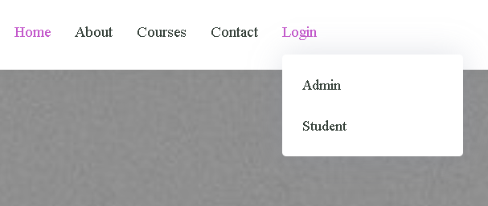
System Implementation
Home Page

Slide 15
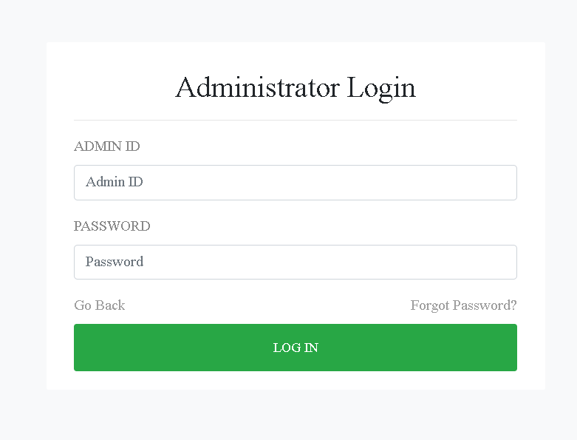
System Implementation
Admin Log in Page

Slide 16
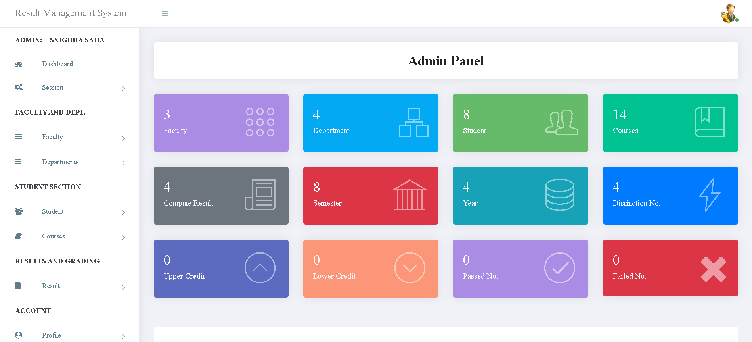
System Implementation
Admin Dashboard

Slide 17
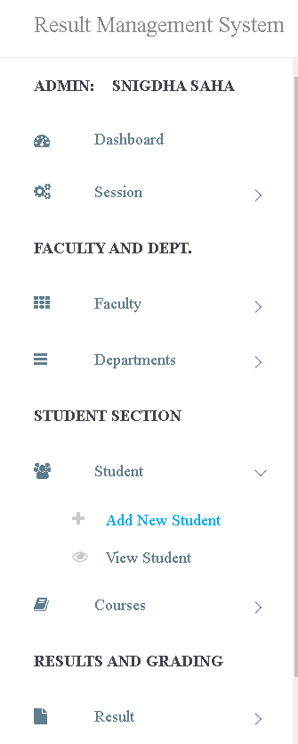
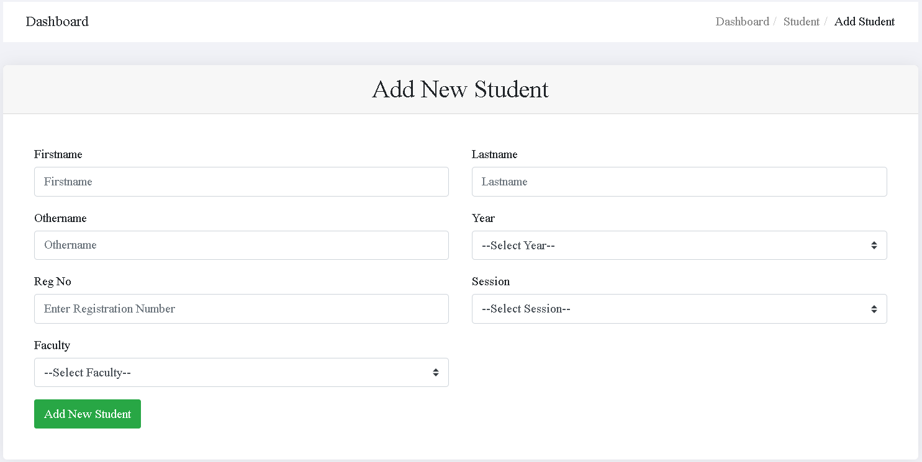
System Implementation
Admin can add new student

Slide 18
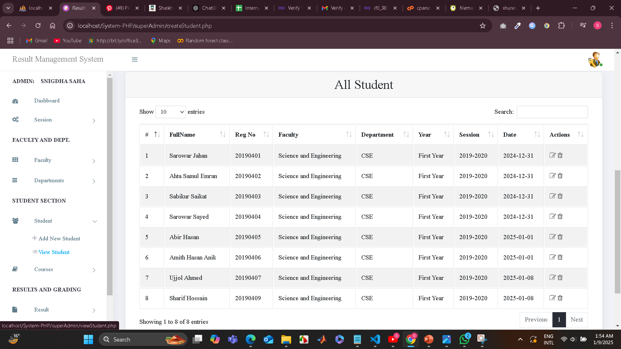
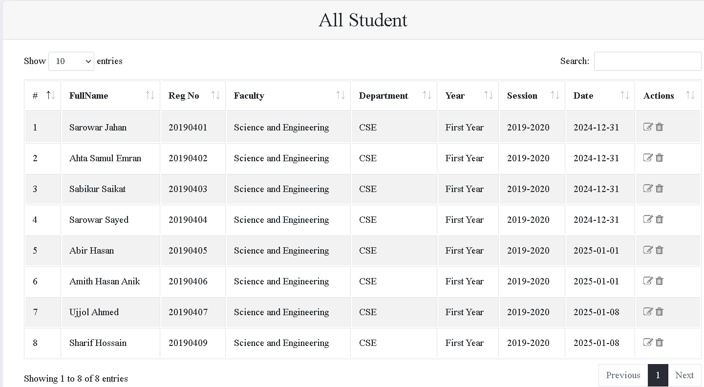
System Implementation
Admin can view student list

Slide 19
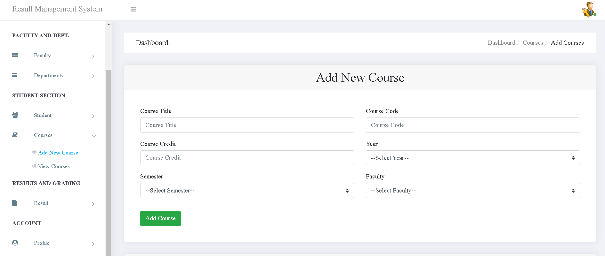
System Implementation
Admin can add courses

Slide 20
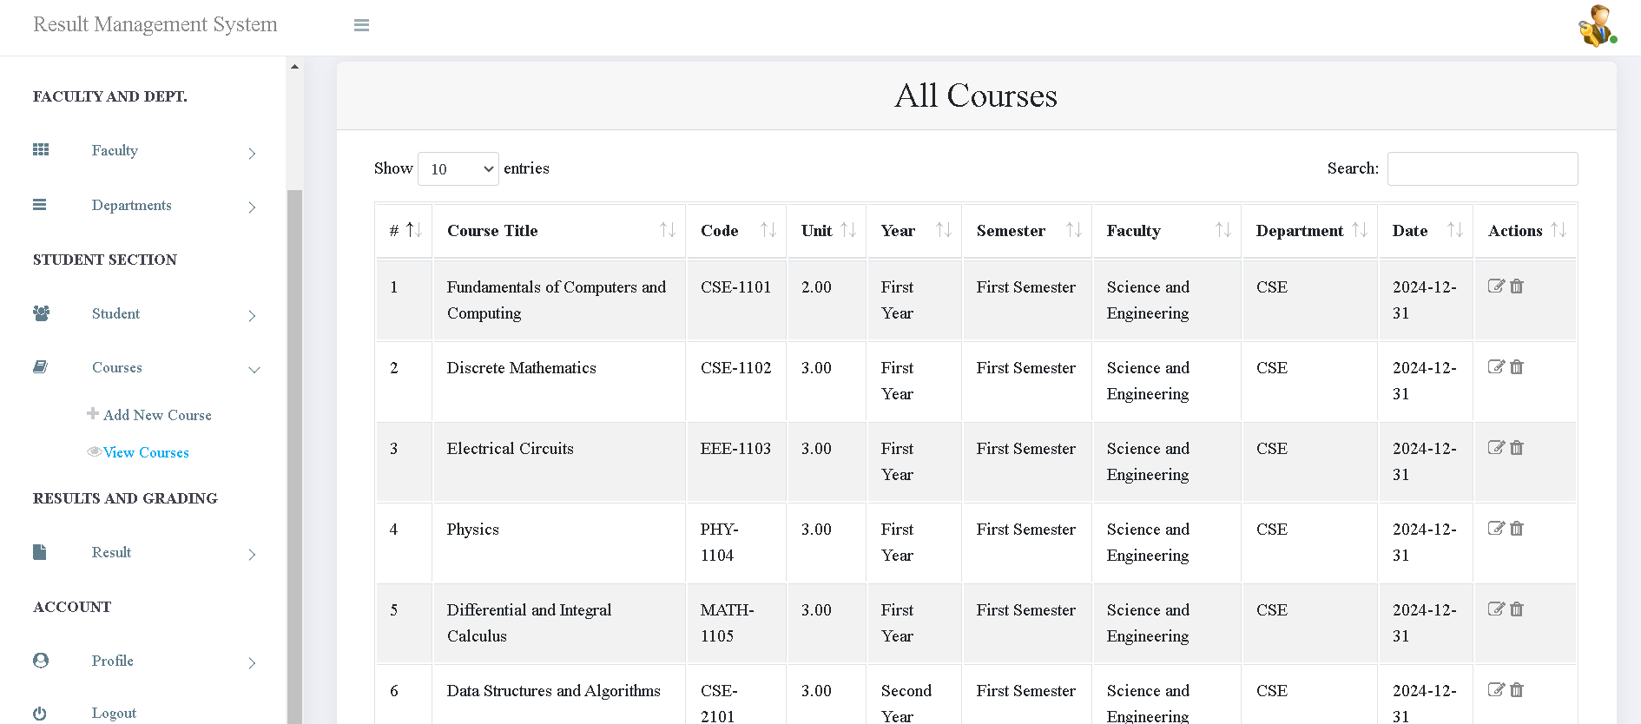
System Implementation
Admin can view course list

Slide 21
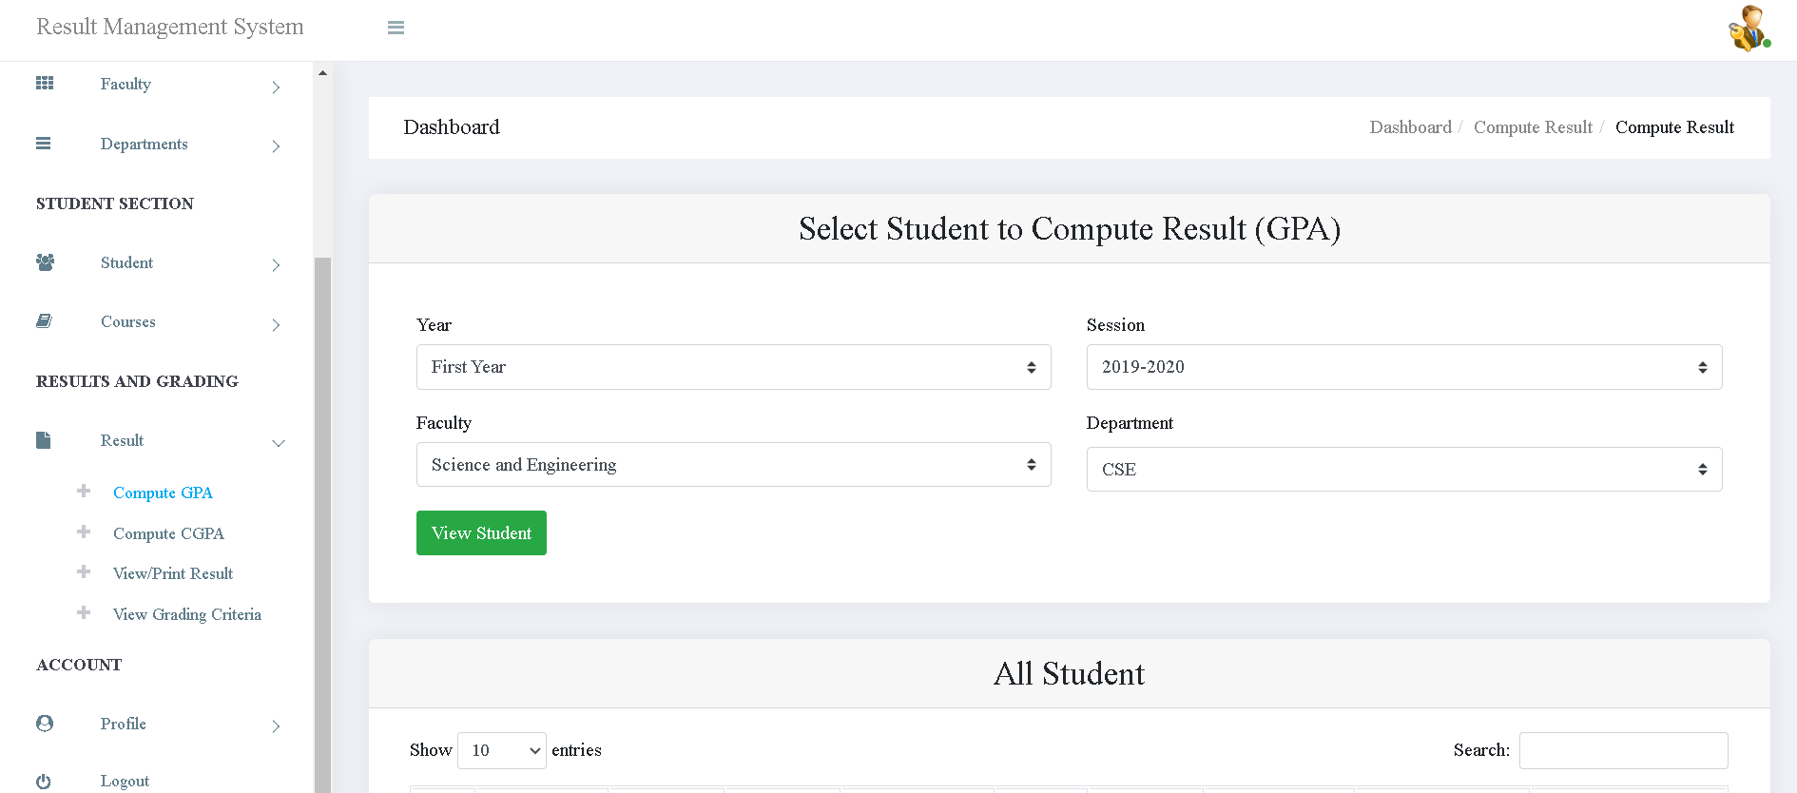
System Implementation
Admin can compute GPA

Slide 22
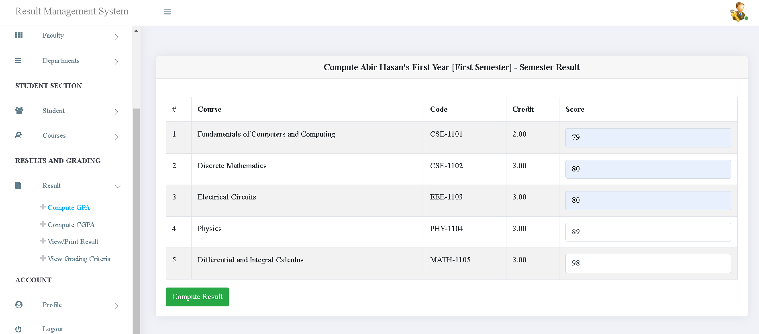
System Implementation
Admin can compute GPA

Slide 23
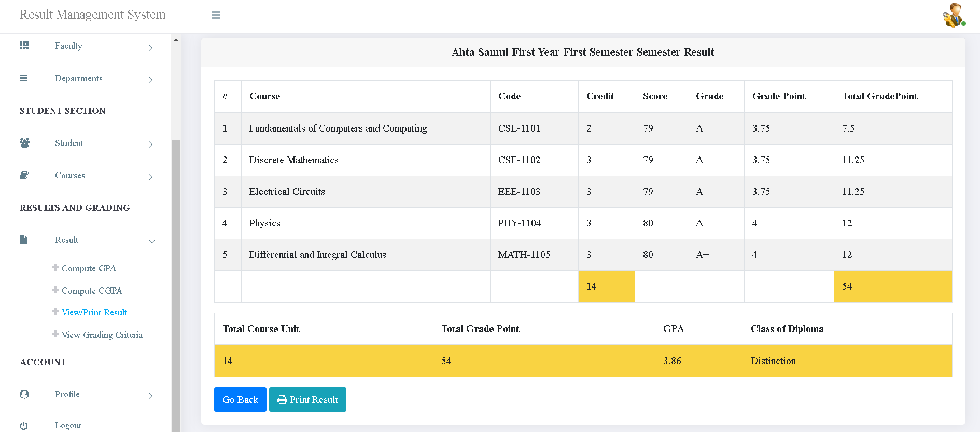
System Implementation
Admin can view/Print result

Slide 24
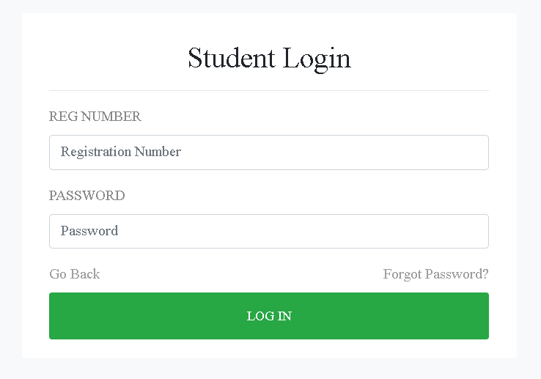
System Implementation
Student Log in Page

Slide 25
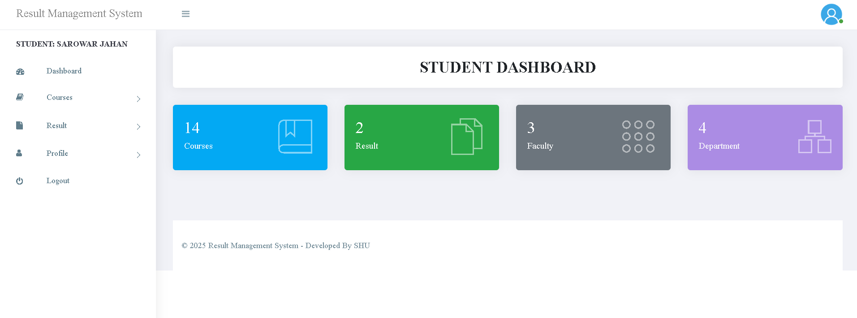
System Implementation
Student Dashboard

Slide 26
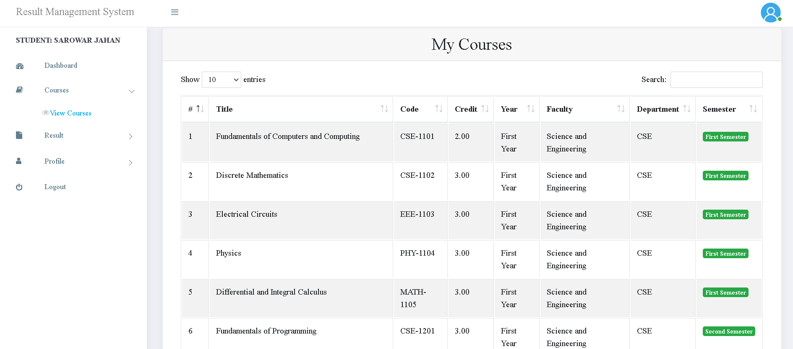
System Implementation
Student can view course list

Slide 27
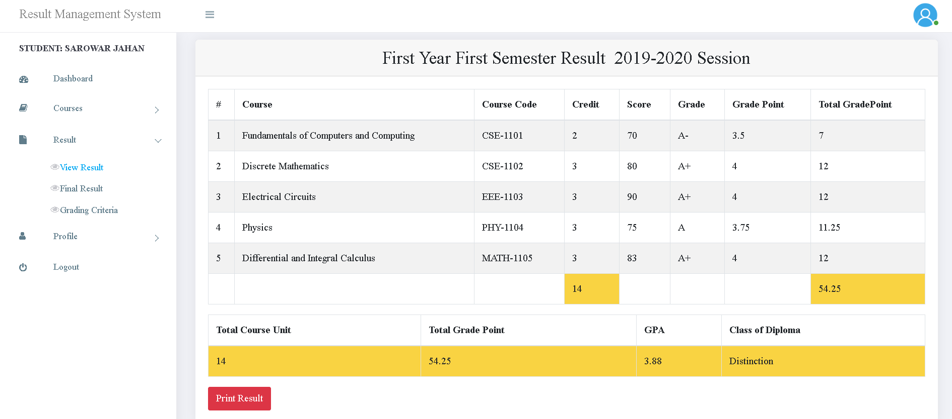
System Implementation
Student can view/print result

Slide 28
Thank You

